Slide 1
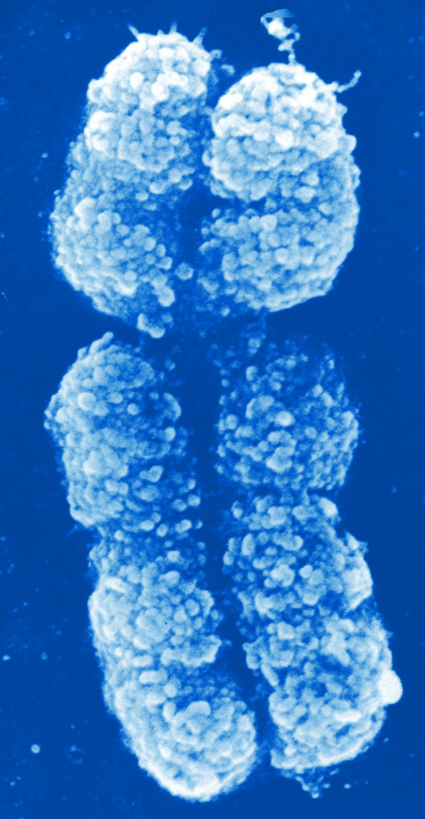
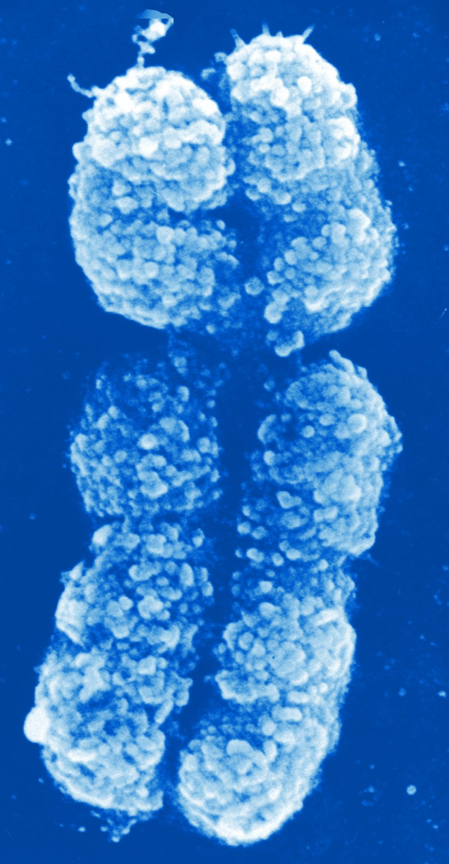
Chromosomes

Slide 2
Chromosomes
Chromosomes in eukaryotes are strands of DNA bound to proteins
Chromosomes usually exist in pairs. There are typically two of each kind in the somatic (body) cells of higher plants and animals.

Slide 3
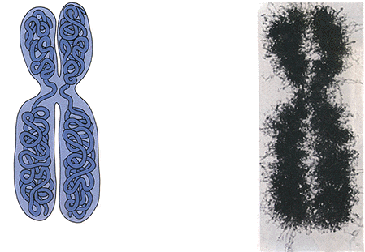
One Chromosome
Chromatids
Centromere
Coiled DNA
(The real thing)

Slide 4
Homologous pairs
The members of a pair are referred to as homologous chromosomes.
Each pair:
  is the same size,
  has the centromere in the same place,
  has the same gene loci in the same sequence. (Loci is plural of locus = place on the chromosome)

Slide 5

A homologous pair
Human chromosome 9
Chromosome from mother
Chromosome from father
Deafness/hearing gene
Deafness/hearing gene

Slide 6
Chromosome numbers
In humans there are 23 pairs of chromosomes. One member of each pair comes from the mother, and one from the father.
Other species have different numbers.

Slide 7
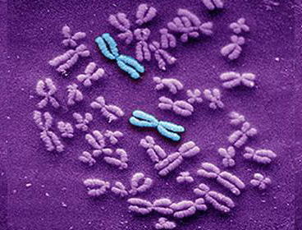
Genome & karyotype
Genome — this is the total of an individual’s genetic material.
A karyotype is a full complement of chromosomes. It is usually shown as a drawing or photograph of stained chromosomes arranged in homologous pairs, from the biggest to the smallest.

Slide 8
Terminology
Gene = a factor that controls the inheritance of a trait
Allele = one form of a gene
Dominant allele = one that is always expressed when present
Recessive allele = one that can be hidden, expressed only when two are present

Slide 9
Symbols
One letter is used for a certain gene
Dominant alleles have a capital letter
Recessive alleles have a small letter
  E.g. for plant height,
    T = allele for tall
    t = allele for short
Other systems are used if more than two alleles exist for a gene, e.g. Blood type: I^{A}, I^{B} and Iº (or just i)

Slide 10
(Terminology continued)
Homozygous = having two alleles the same, e.g. TT (homozygous dominant)
  or tt (homozygous recessive)
Heterozygous = having two different alleles, e.g. Tt
Genotype = The alleles present, e.g. TT, Tt or tt
Phenotype = The appearance or the result of the genotype, e.g. tall plants

